Slide 1
GUI Backend
Code structures and techniques behind the beauty

Slide 2

Event Systems
Around and around the event system goes...

Slide 3
Event Systems
Around and around the event system goes...
Basic concept is a loop

Slide 4
Event Systems
Usually branches from main stack.
Main
initializeStuff();
….
// Create Event Object
event_object.execute()
…
cleanup();
return;

Slide 5
Event Systems (User defined)
Main
initializeStuff();
….
// Create Event Object
while(getting_user_input)
...
…
cleanup();
return;
A fundamental concept for any application with user I/O.

Slide 6
Event Systems (Non-Extensible)
Application inside event system
void doSomething(int age)
{
age += 5;
….
cout << “age in 5 years ”
<< age;
}
Cin << userAge
“age in 5 years...”
(Event Processing)

Slide 7
Event Systems (Non-Extensible)
Application inside event system
void doSomething(int age)
{
age += 5;
….
cout << “age in 5 years ”
<< age;
}
Cin << userAge
“age in 5 years...”
(Event Processing)
Just a “run” loop wrapped around I/O processing

Slide 8
Event Systems (extensible)
Container for Events
(Event Passing)

Slide 9
Event Systems (extensible)
Container for Events
Delegation
(Event Passing)

Slide 10
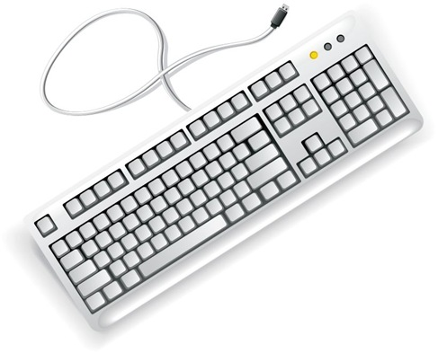
Event Systems (extensible)
Container for Events
Input
Delegation
(Event Passing)

Slide 11
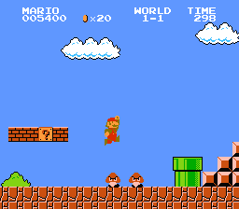
Event Systems (extensible)
Container for Events
Input
Output
Delegation

Slide 12
Event Systems (extensible)
Container for Events
Sender
Receiver
Delegation

Slide 13
Event Systems (extensible)
Container for Events
Signal
Handler
Delegation

Slide 14
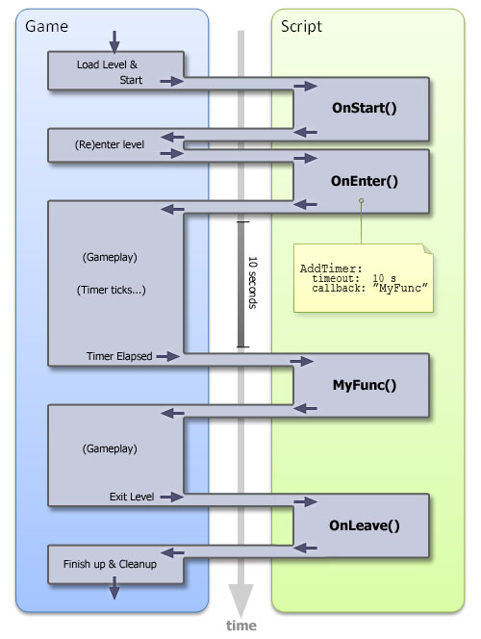
Signals and Handlers (Slots)
A signal happens
One (to many) function handlers will be called

Slide 15
Signals and Handlers (Slots)
A signal happens
One (to many) function handlers will be called
The event system is working behind the scenes

Slide 16
Signals and Handlers (Slots)
A signal happens
How is this accomplished?
One (to many) function handlers will be called
The event system is working behind the scenes

Slide 17
Event Queueing
While the event system runs...
Event Stack

Slide 18

Event Queueing (Input Phase)
I/O processing functions monitor Input
Event Stack
Check keys
Check Mouse

Slide 19
Event Queueing (Input Phase)
When input occurs the Event System creates an event on the stack
Event Stack
Check keys
Key ‘a’ down
Check Mouse

Slide 20
Event Queueing (Input Phase)
Many events can be queued on the stack
Event Stack
Check keys
Key ‘a’ down
Key ‘9’ down
Mouse btn_1 pressed
Key ‘c’ down
Key ‘d’ down
Check Mouse
...

Slide 21
Event Queueing (Delegation Phase)
Once current input data is queued, the event system begins delegating
Event Stack
Key ‘a’ down
Key ‘9’ down
Mouse btn_1 pressed
Key ‘c’ down
Key ‘d’ down
...

Slide 22
To Delegate:
entrust (a task or responsibility) to another person, typically one who is less senior than oneself
https://www.google.com/?ion=1&espv=2#q=definition+delegate

Slide 23

To Wrangle:
round up, herd, or take charge of (livestock events).
https://www.google.com/?ion=1&espv=2#q=definition+wrangle

Slide 24
Event Queueing (Delegation Phase)
Handler A
Negotiation of “handler” and seniority happens prior (connections).
onDigit9Pressed:{
...
}
HandlerA->event(digit_event)
Event Stack
Key ‘a’ down
Handler B
Key ‘9’ down
onKeyPressed:{
...
}
HandlerB->event(key_event)
Mouse btn_1 pressed
Key ‘c’ down
Key ‘d’ down
...

Slide 25
Event Queueing (Handler Phase)
Handler A
Actual execution of the function bodies
onDigit9Pressed:{
spriteImg.rotation += 10;
}
HandlerA->event(digit_event)
Event Stack
Key ‘a’ down
Handler B
Key ‘9’ down
onKeyPressed:{
if(event.key == ‘c’)
mainWindow.copyObj();
}
HandlerB->event(key_event)
Mouse btn_1 pressed
Key ‘c’ down
Key ‘d’ down
...

Slide 26
Event Queueing (Handler Phase)
Handler A
Actual execution of the function bodies
onDigit9Pressed:{
spriteImg.rotation += 10;
}
Handler B
onKeyPressed:{
if(event.key == ‘c’)
mainWindow.copyObj();
}

Slide 27
Event Queueing (Handler Phase)
Actual execution of the function bodies
Simple functions - executes and returns
Handler B
Handler A
onKeyPressed:{
if(event.key == ‘c’)
mainWindow.copyObj();
}
onDigit9Pressed:{
spriteImg.rotation += 10;
}

Slide 28
Event Queueing (Handler Phase)
Actual execution of the function bodies
Simple function??
Handler B
Handler A
onKeyPressed:{
if(event.key == ‘c’)
mainWindow.copyObj();
}
onDigit9Pressed:{
spriteImg.rotation += 10;
}

Slide 29
Event Queueing (Handler Phase)
Actual execution of the function bodies
Simple function??
mainWindow.copyObj()
copyObj()
{
QList<QObject*> kids = this->children();
foreach( QObject *kid in kids)
{
QObject * new_kid = new QObject();
kid->copyObj(new_kid);
...
}
}
Handler B
onKeyPressed:{
if(event.key == ‘c’)
mainWindow.copyObj();
}

Slide 30
Event Queueing (Handler Phase)
Actual execution of the function bodies
Simple function??
mainWindow.copyObj()
copyObj()
{
QList<QObject*> kids = this->children();
foreach( QObject *kid in kids)
{
QObject * new_kid = new QObject();
kid->copyObj(new_kid);
...
}
}
Handler B
onKeyPressed:{
if(event.key == ‘c’)
mainWindow.copyObj();
}
Long Blocking Process - - prevents input phase

Slide 31
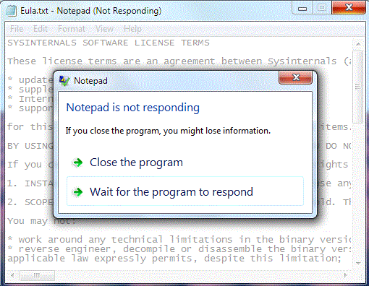
GUI thread stops handling events
The kernel attempts to deliver the input messages but they are dropped instead of queued. After the application fails to respond for long enough the window manager steps in.

Slide 32

The Solution - WORKER THREADS
Monday Week 7 - Advanced C++ integration and worker threads!

Slide 33


Readings This Weekend (week 6)
Dynamic Views (Chapter 6.3)
http://qmlbook.github.io/en/ch06/index.html#dynamic-views
Dynamic QML(Chapter 13)
http://qmlbook.github.io/en/ch13/index.html
Qt and C++ (Chapter 15)
http://qmlbook.github.io/en/ch15/index.html
Events and filters
http://doc.qt.io/qt-5/eventsandfilters.html
Qt/Qml Signals
http://doc.qt.io/qt-5/qtqml-syntax-signals.html
Dynamic Object Creation JS
http://doc.qt.io/qt-5/qtqml-javascript-dynamicobjectcreation.html

Slide 34

Javascript Memory Management
Live code demo.

